Slide 1
PROJECT REPORT CMPS 470/570
TEAM: B.C.
Brittney Jarreau, Caleb Charpentier, Leanne Nicholas

Slide 2
TEAM MEMBERS & ROLES
Brittney Jarreau - Dataset formation, Data Preprocessing, SVM, SVM Analysis
Caleb Charpentier – Data Preprocessing refactor, Command line design, ANN, ANN Analysis
Leanne Nicholas - Decision Tree, Decision Tree Analysis

Slide 3
DESCRIPTION OF THE PROJECT
This project uses a dataset of amplitude, phase, transfer function amplitude, and transfer function phase to distinguish between labels Hole and No Hole
The project compares the outcome of Decision Tree Classifier, Support Vector Machine, and Artificial Neural Network to determine which approach is the most appropriate to use in classifying this data.

Slide 4
DESCRIPTION OF THE DATA
Acoustic Probing of Circular Metallic Medium
https://github.com/bjarreau/ML4MI/blob/main/Acoustic_Probing.csv
Samples: 540 Attributes: 63
Dataset comes from Brittney’s thesis research. Data was collected but using 2 transducers to send a signal through a metallic specimen and collect the signal on the other side.
Attributes | Data Type | Description
ID | discrete | id of sample 0-539
Amplitude at x | continuous | amplitude in mV at some location (x ranges from -7 to 4)
Tx Amplitude at x | continuous | amplitude of transfer function in mV at some location (x ranges from -7 to 4)
Phase at x | continuous | Phase angle at some location (x ranges from -7 to 4)
Tx Phase at x | continuous | Phase angle of transfer function in mV at some location (x ranges from -7 to 4)
Label | categorical | Label of test scenario - values are Hole, No Hole, Hole-Filled, Hole Shifted, No Hole Shifted, Hole-Filled Shifted, Hole Shifted Left, No Hole Shifted Left, Hole-Filled Shifted Left,
Trial | discrete | Integer Trial number 1-5

Slide 5
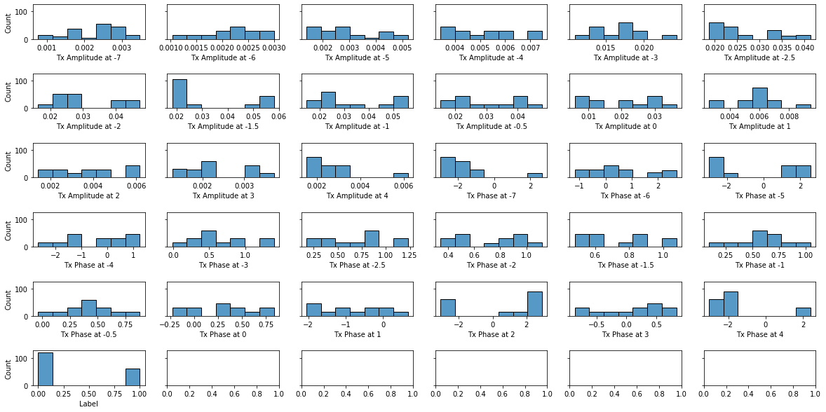
Dataset Distribution After Initial Reduction

Slide 6
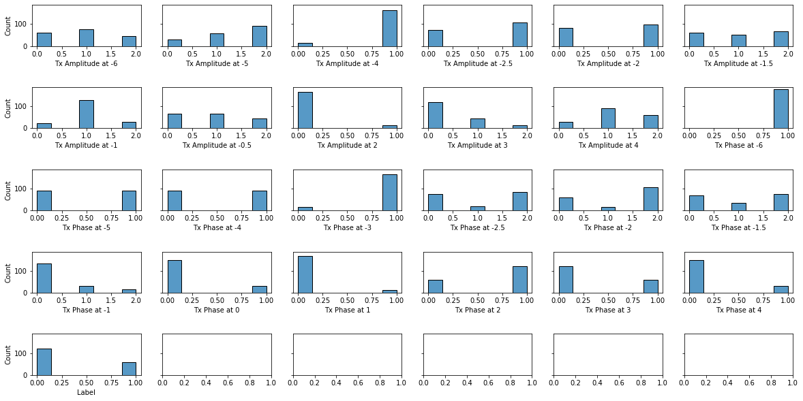
DECISION TREE PREPROCESSING – Step 1
For the Decision Tree Preprocessing data had to be discretized. This was done by supplying categories as the slope between each point.

Slide 7
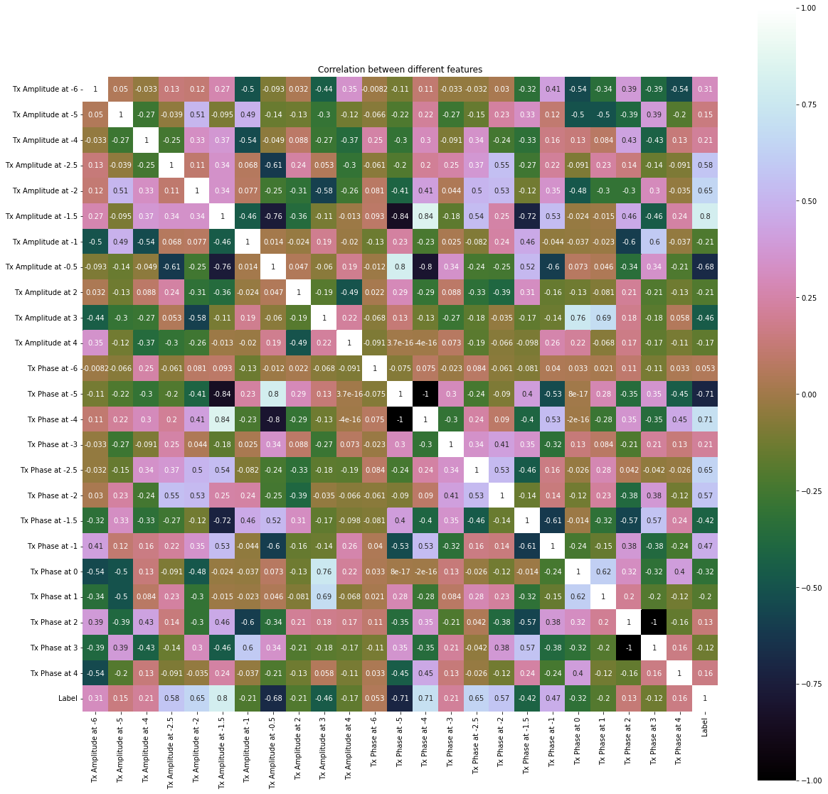
DECISION TREE PREPROCESSING – Step 2
Next Data had to be reduced – this was done via correlation analysis
Highly Correlated Attributes were consolidated
Attributes not correlated with the label were dropped

Slide 8
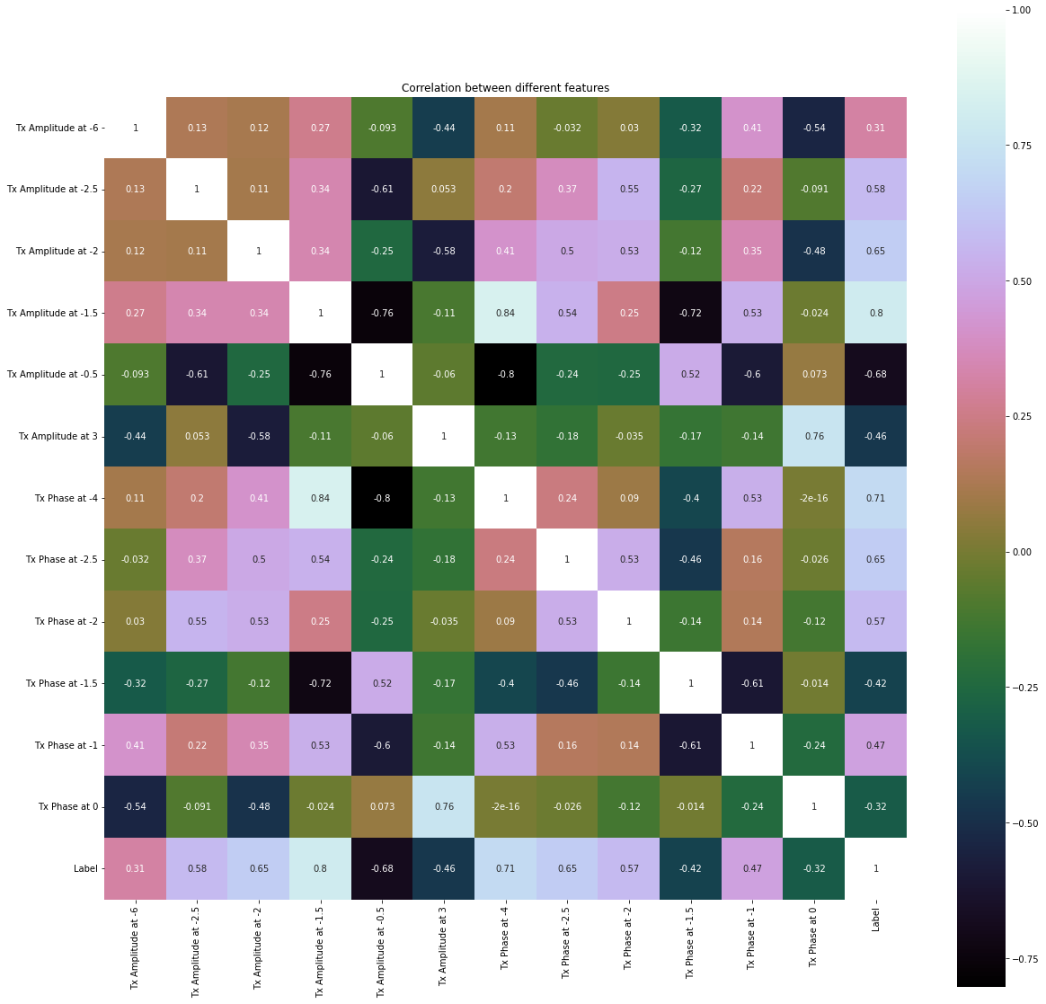
Final Decision Tree Dataset
Using correlation analysis, data was reduced to 13 attributes all at least 25% correlated to the label and none more than 80% correlated to another attribute.

Slide 9
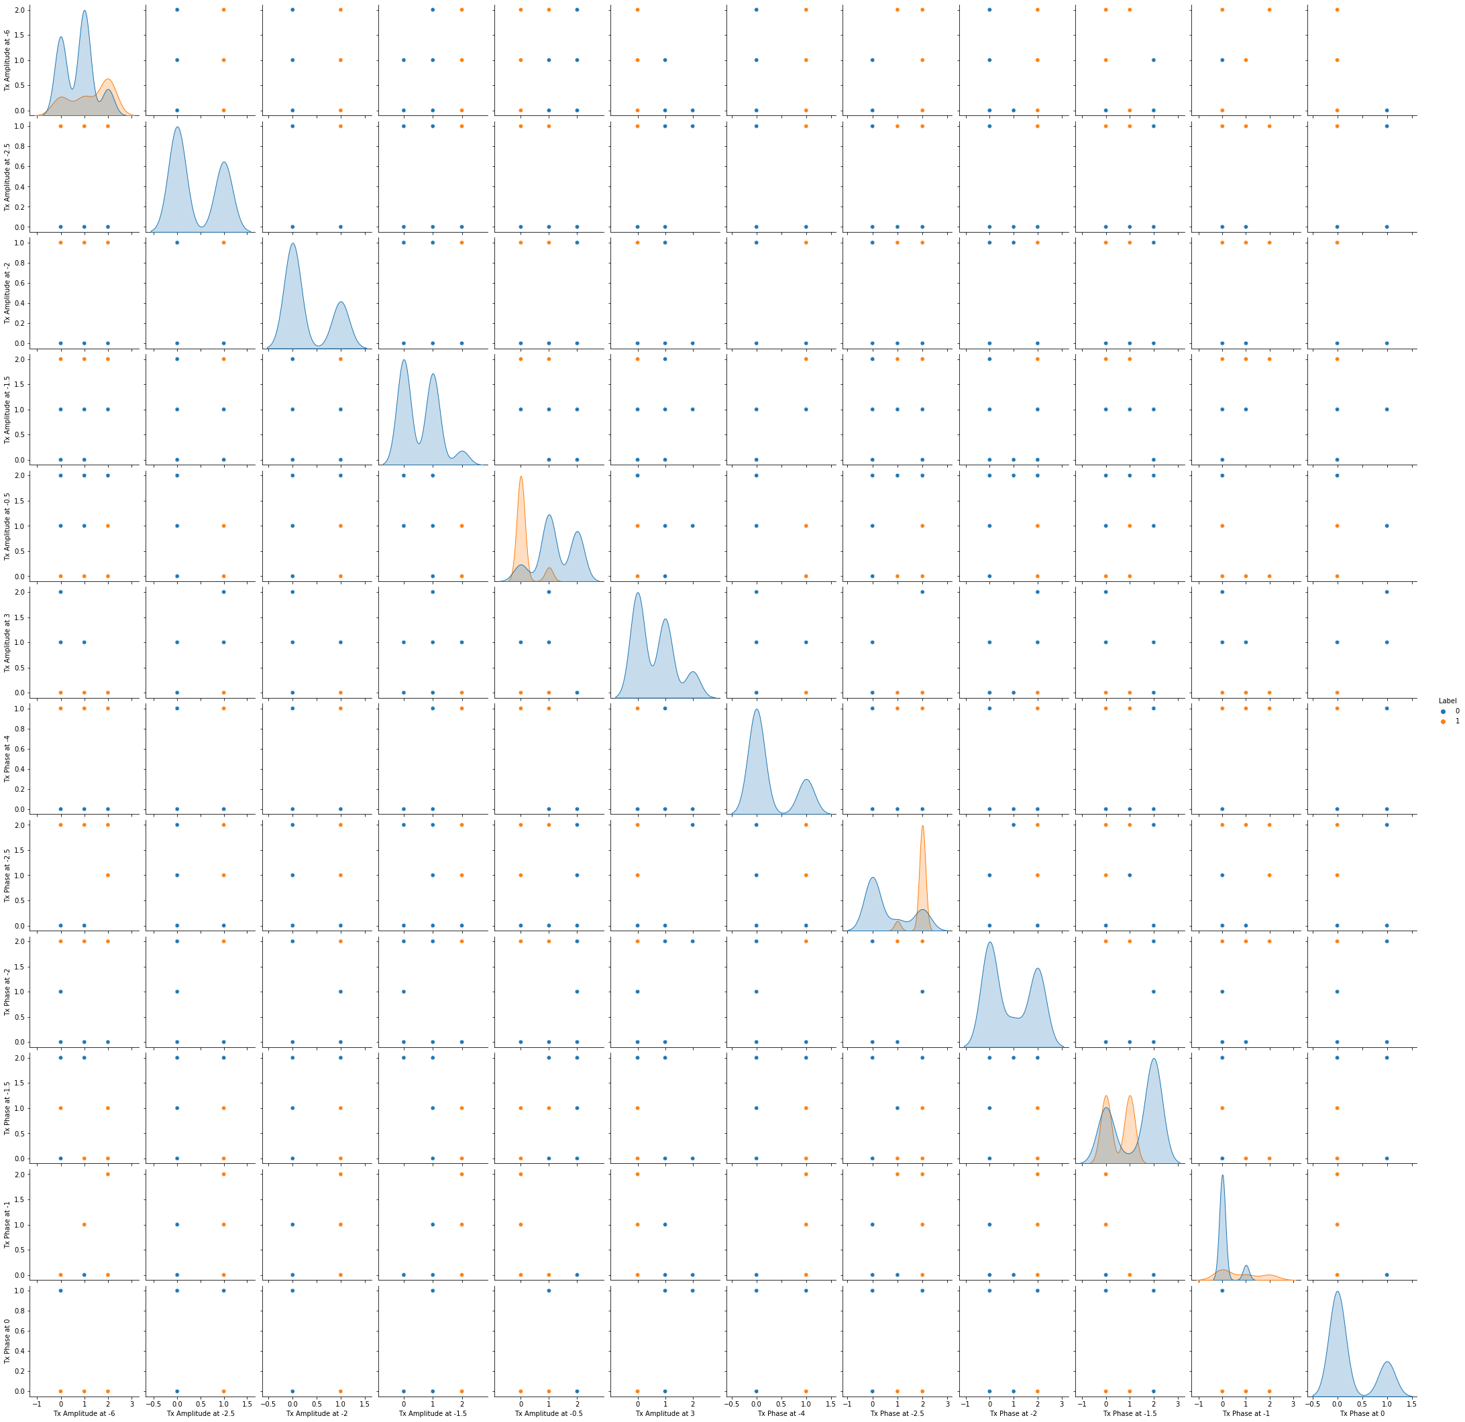
Separation of Decision Tree Dataset
It is difficult to see a clear cut clustering that leads to a determination, but there are many decision boundaries which may be combined to reach a determination

Slide 10
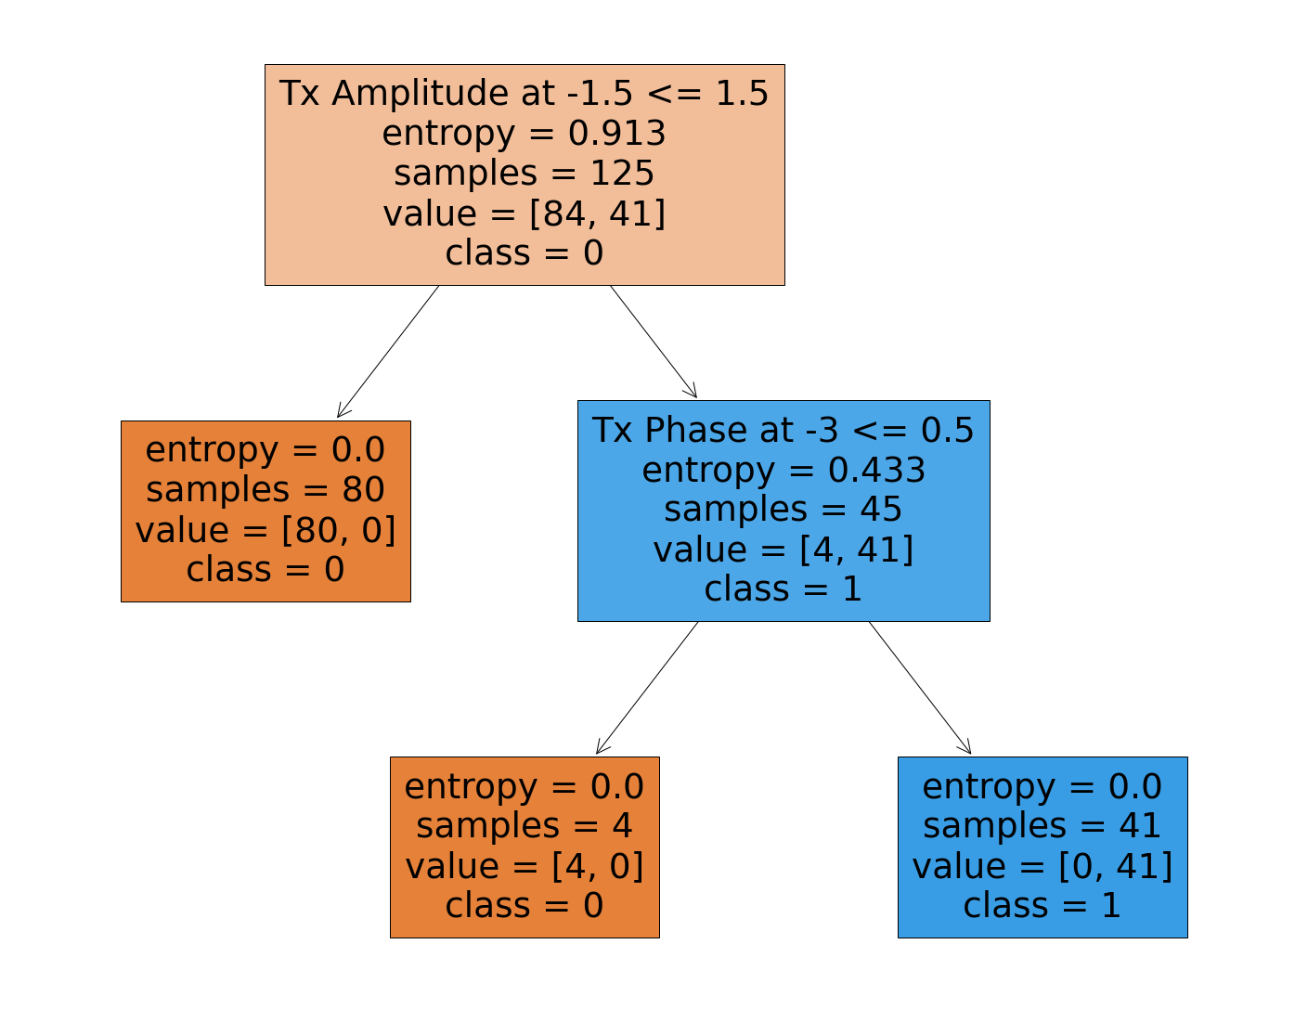
Decision Tree Classifier
Two Decision Tree classifiers were run – 1 with Gini criterion, 1 with Entropy criterion
Cutoff was 8 levels
Data was split into 70% training data and 30% testing data

Slide 11
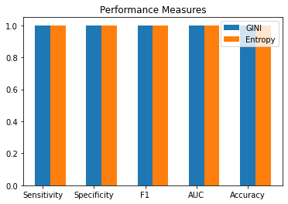

Decision Tree Performance
(sum(pos > neg) + sum(pos == neg)/2) / N
This model was assessed using the F1-score, Sensitivity, Specificity, and Accuracy
Training data was 70% and Validation data was 30%
$$Sensitivity=\frac{TP}{TP+FN}=1 →All predicted positive are truly positive$$
$Specificity=\frac{TN}{TN+FP}=1$ $→All predicted negative are truly negative$
$$Accuracy=\frac{TN+TP}{n}=1 →All predictions are correct$$
$$F1= \frac{2TP}{2TP+FP+FN}=→There were no false positives or false negatives$$
AUC = 1 -> The model is classifying perfectly

Slide 12
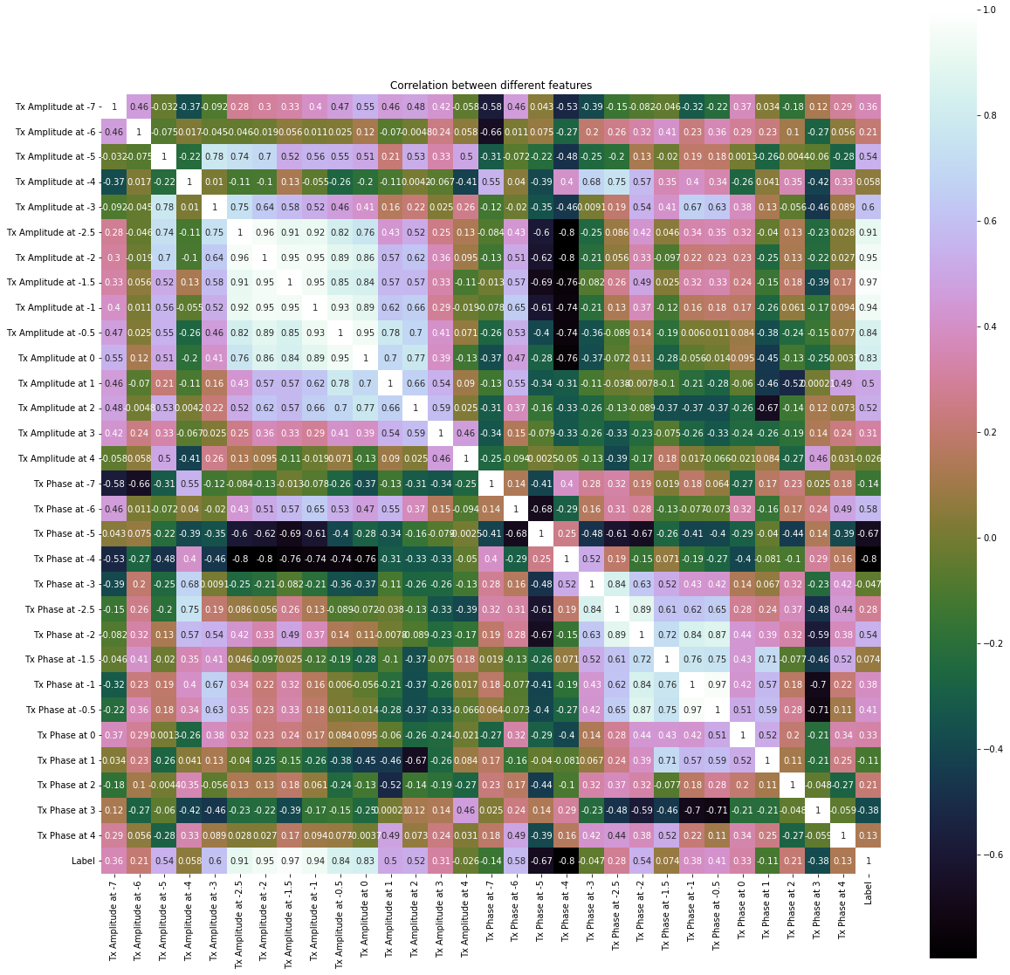
SVM & ANN PREPROCESSING
Data had to be reduced – this was done via correlation analysis
Highly Correlated Attributes were consolidated
Attributes not correlated with the label were dropped

Slide 13
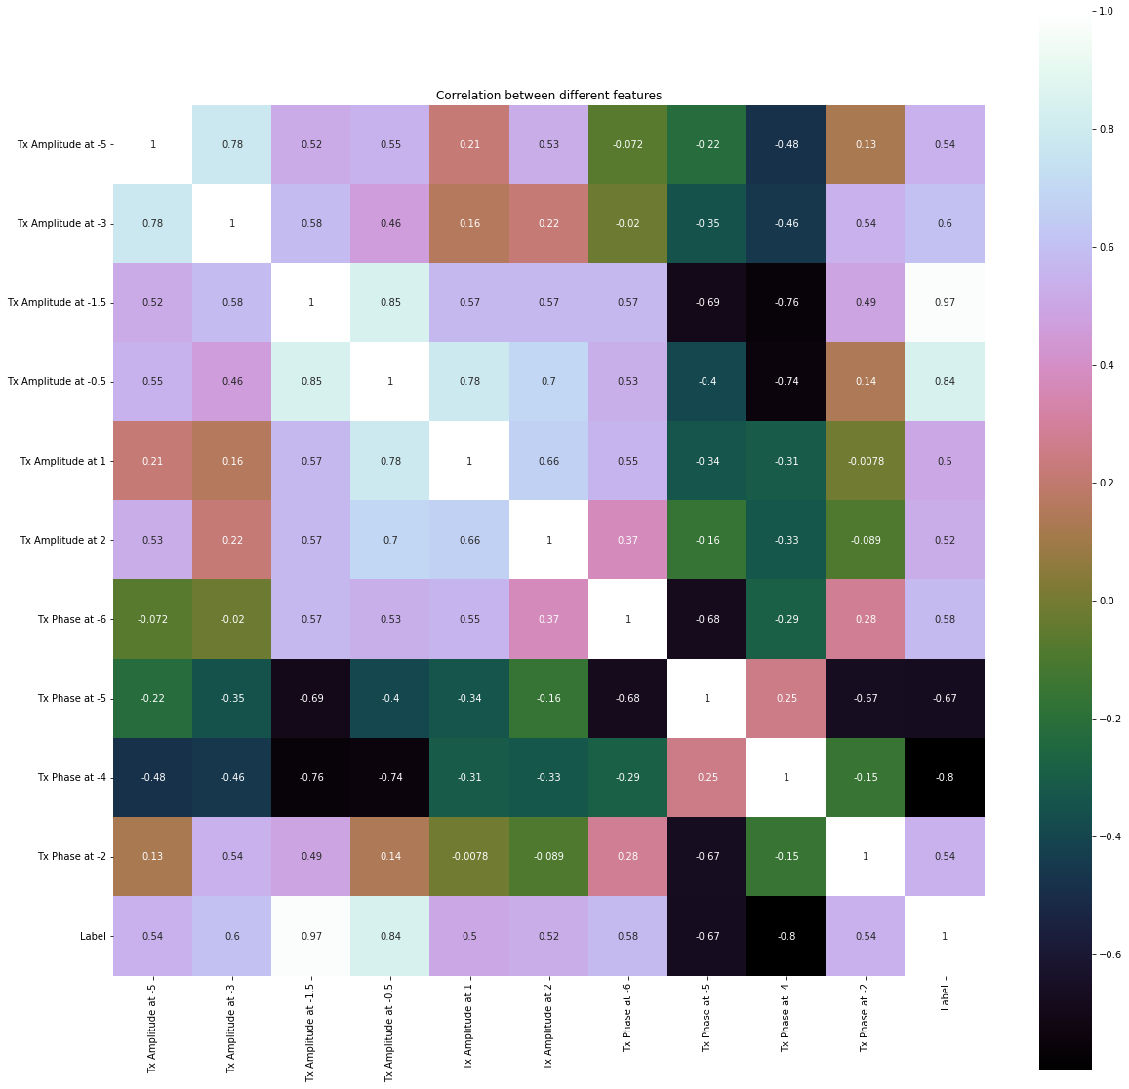
Final SVM & ANN Dataset
Using correlation analysis, data was reduced to 11 attributes all at least 20% correlated to the label and none more than 80% correlated to another attribute.

Slide 14
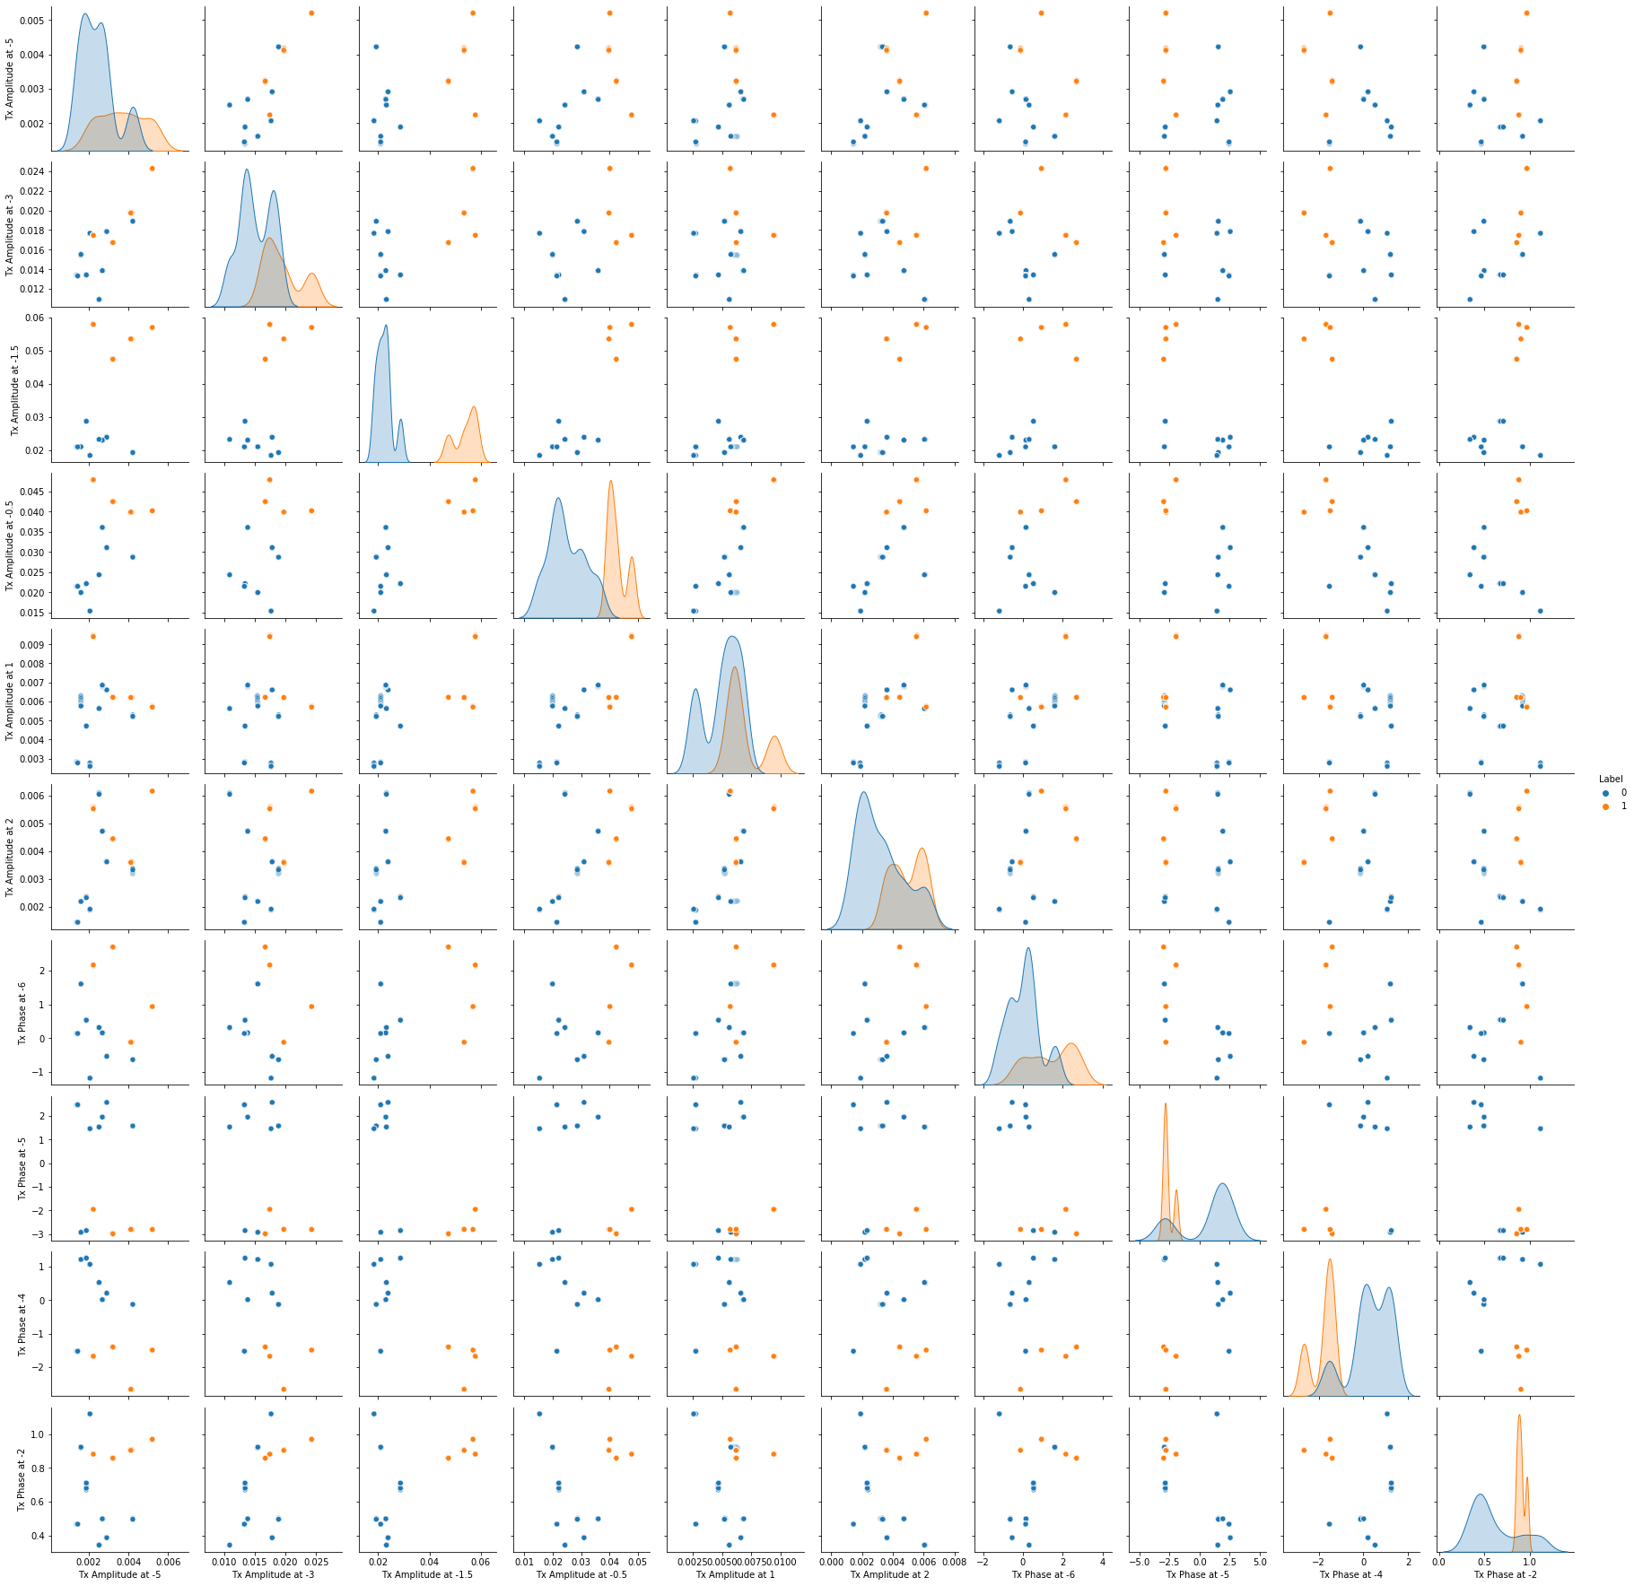
Separation of SVM & ANN Dataset
Analysis reveals that SVM should be able to distinguish between the datasets as there are clearly attributes which lead to separable classes

Slide 15
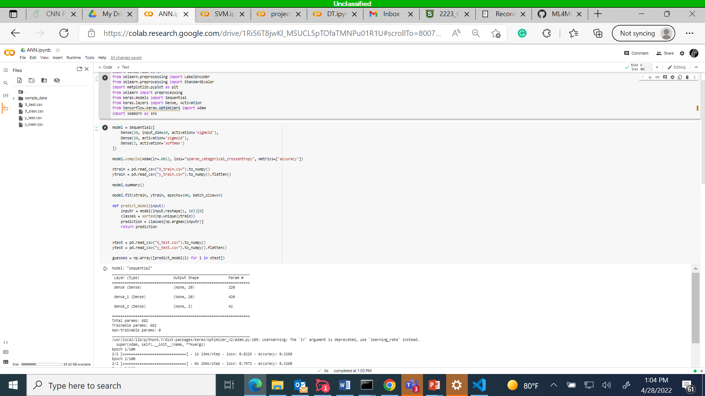
ANN Classifier
The model has an input layer with 10 nodes and a ReLU activation
A hidden layer with 20 nodes and a ReLU activation function
And an output layer which goes from 20 input nodes to 2 output nodes using the softmax function
The model also uses an Adam optimizer with a learning rate of 0.0005
The model also uses early stopping to quit training if the loss does not decrease by at least 0.001 for 2 epochs

Slide 16
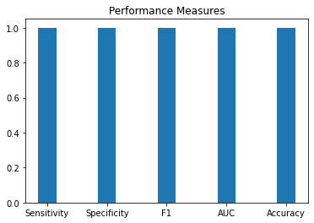
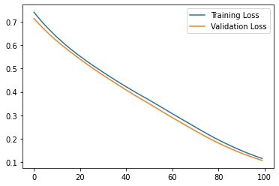
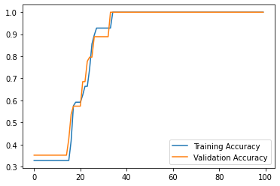

ANN Performance
This model was assessed using the F1-score, Sensitivity, Specificity, Accuracy, and the ROC
Training data was 70% and Validation data was 30%
$$Sensitivity=\frac{TP}{TP+FN}=1 →All predicted positive are truly positive$$
$Specificity=\frac{TN}{TN+FP}=1$ $→All predicted negative are truly negative$
$$Accuracy=\frac{TN+TP}{n}=1 →All predictions are correct$$
$$F1= \frac{2TP}{2TP+FP+FN}=→There were no false positives or false negatives$$
AUC = 1 -> The model is classifying perfectly
Epoch Curves indicate no overfitting or underfitting has occurred, although the jagged nature means learning rate may be too high

Slide 17
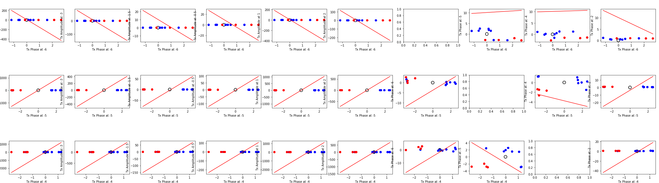
SVM Classifier
The SVM used applies a linear kernel
Data was split into 70% training data and 30% testing data

Slide 18


SVM Performance
This model was assessed using the F1-score, Sensitivity, Specificity, and Accuracy
Training data was 70% and Validation data was 30%
$$Sensitivity=\frac{TP}{TP+FN}=1 →All predicted positive are truly positive$$
$Specificity=\frac{TN}{TN+FP}=1$ $→All predicted negative are truly negative$
$$Accuracy=\frac{TN+TP}{n}=1 →All predictions are correct$$
$$F1= \frac{2TP}{2TP+FP+FN}=→There were no false positives or false negatives$$
AUC = 1 -> The model is classifying perfectly

Slide 19
Conclusions
Since the subset of data used in this experiment has proven to be highly separable, distinguishing between the hole and no hole is a linear problem.
Since all models where able to perform a perfect classification, all models are a good selection for classification of this data and whichever is able to perform the classification using the least resources should be selected.

